Slide 1
How To Create Your
Climate Action Plan
Presenter Names
Summit Name
Presentation Date
Add your information here!
Notes:
Slide 1: Introduction
Hello - Hello everyone and welcome to the Climate Action Plan workshop! We hope you’ve all been having a great time and learning a lot at the workshops and you’re ready to put your knowledge and excitement to work!
Introductions - My name is ________, I use ________ pronouns, and I’m from _______ school. I will be facilitating this workshop today along with ________ (hand it off, have everyone say names, pronouns and school).
We’re here today to walk you through the process of designing your own climate action plan for your school or community. This is one of the most important workshops of the summit because it focuses on how you are going to take action to address climate change. We all came here today to learn how to take action! Can I get a show of hands of who has made a CAP before? How about those of you who are doing this for the first time?
Before we get started, let’s go through the agenda quickly.

Slide 2
Introduction
How To CAP
Making your CAP!
Group Share Out
Resources & Next Steps
AGENDA
2
Notes:
Slide 2: Agenda
After this introduction, we’ll run through making your CAP. Next, you’ll have time to brainstorm and plan with your team. Everyone will come back here for the share out and we’ll discuss some useful resources and next steps for your plans.

Slide 3
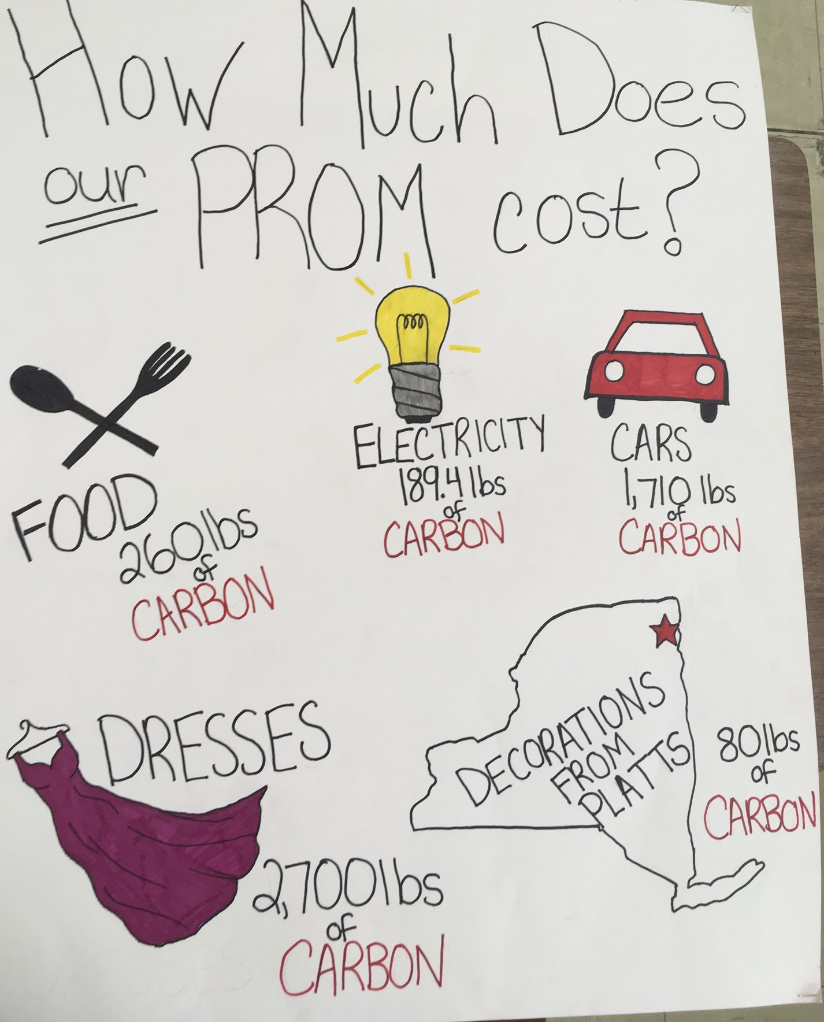
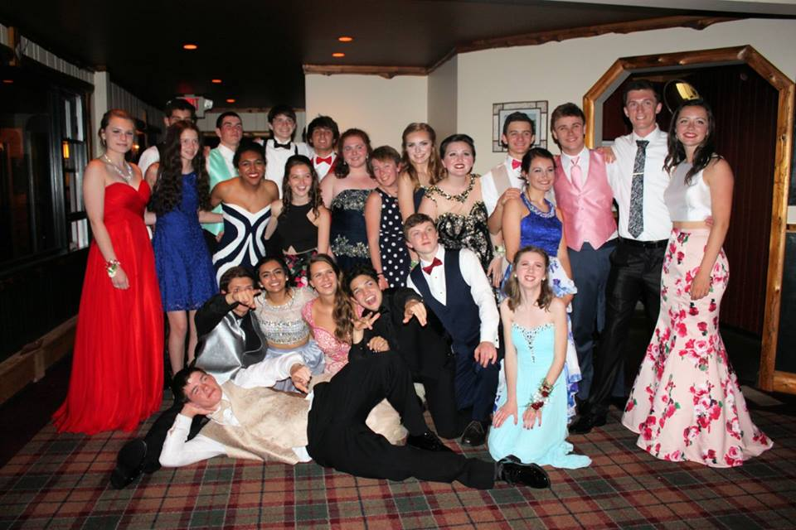
You can change this slide to have pictures of student-led projects in your region
Notes:
Slide 3: What is a CAP and What Do Successful CAPs Look Like?
For this portion, identify beforehand any local students that have implemented successful climate change and/or sustainability projects in their schools. Work with these students before the summit to see if they would like to briefly present on their work. Ask them to come up and share their stories (30 seconds -1 minute each). You can add pictures/videos the slide deck to show your local successes.
If this is a new summit, use the example below:
Carbon Neutral Prom Example - One group in past years wanted to increase awareness of climate change and decisions that increase CO2 emissions in their school. They decided the best forum to accomplish this in a fun way was at their prom. Here are some photos from that project.

Slide 4
STEP 1: Brainstorm.
What Could Be Improved at Your School?
Notes:
Slide 4: Brainstorm
During this workshop, you and your school team are going to be creating a Climate Action Plan for your school or community. This project will be all yours - you will brainstorm, design, and make your project happen from the ground up. We’re going to walk through the process together before you break up into school teams to create your plan.
You’re going to start your planning by thinking about your school, where it faces environmental problems, what resources are available to assist with your projects and what your team is passionate about. Some students find it helpful to make a map or a list of problems, resources and potential solutions.
Use your map or list to match up the problems with solutions and passions that address the problem. This can help you narrow down your project options and select a project idea that you have a good chance of completing successfully.

Slide 5
STEP 2: Develop a project idea from the brainstorm session. What topic areas will this project cover?
^{Energy Efficiency and Use}
^{Water Efficiency and Use}
^{School Gardening}
^{Chemical Use}
^{Local Food}
^{Composting}
^{Transportation}
^{Policy}
^{Waste Management}
^{Curriculum}
^{Community Engagement/Outreach}
^{Other ______}
Notes:
Slide 5: Topic Areas
There are so many ways that schools can help implement climate change solutions. Topic areas such as energy use, transportation, food systems, community outreach, waste management, and policy all play a role in school function and that means you can influence these issues. What topic areas match up with the problems, solutions and passions you identified during the brainstorm session?

Slide 6
STEP 3: Set up 3-5 goals for this project that are:
^{SPECIFIC}
^{MEASURABLE}
^{ACHIEVABLE}
^{REALISTIC}
TIME-BOUND (achievable by a certain date)
^{INCLUSIVE}
^{EQUITABLE}
Notes:
Slide 6: Project Goals
Think big picture. Once your group has picked a topic you can address at your school, make some big picture goals. Who has heard of SMART goals? Here’s what SMARTIE stands for:
Specific and Measurable- It is important that the goal is specific so that you can measure how well you achieved it. If the goal is too vague, it’s harder to measure your success. An example of a specific goal for the Carbon Neutral Prom was making at least two signs for publicity. That’s a goal that is both specific and easily measured. Goals that are specific and measurable also make it easier to break up the project into individual assignments.
For example, students may have a general idea that they want to improve recycling in their school, but this is not specific. What needs to be improved? Education, physical bins or cooperation with administration? Where exactly in the school does it need to be improved? Outside or in the classrooms, or in the cafeteria?
In addition to saying what you would like to improve, it is important that you specify what is going wrong and where it is going wrong.
Achievable and Realistic- While stopping all fossil fuel consumption in the United States is a super cool goal, it might not be the most achievable goal for your first CAP. Try to think about scale and what areas you as students can influence the most. If you don’t have a goal that’s achievable, it’s easy to lose momentum or feel demoralized.
For the Carbon Neutral Prom, our goal of fundraising money just to offset the CO2 produced at prom was extremely achievable. *Note- We highly discourage plans that just involve fundraising for a cause. While the Carbon Neutral Prom did raise money to participate in an offset program, the larger aspect of the plan was raising awareness at prom and in the school for how certain actions increase our carbon footprint.
Time Bound- Having goals that are set to specific deadlines are extremely important so that you can constantly evaluate if you’re on track to meet the goal. It also keeps the finish line in reach! Be sure to have aspects of your climate action plan that you can successfully complete in one school year. You may have high aspirations, and you are encouraged to make long term goals up to 5 years within the action plan worksheet, but the initial goal should be something with a timeline shorter than one school year.
Inclusive- It is essential that our goals work towards inclusivity. They should bring traditionally marginalized people—particularly those most impacted—into processes, activities, and decision/policy-making in a way that shares power as much as possible.
Equitable- Equity must be an integral aspect of the CAP process. Goals should include seeking to address systemic injustice, inequity, and/or oppression.

Slide 7
S.M.A.R.T.I.E
Goals
Notes:
Slide 7: SMARTIE Goals
Okay does everyone remember what SMART means? Okay, let's say it together 1-2-3 - (Everyone) Specific, Measurable, Achievable, Realistic, Timebound, Inclusive Equitable

Slide 8
STEP 4: Who will make this project happen? Identify these people by name. This checklist will help you think about possible participation.
^{Students}
^{Faculty}
^{Administrators}
^{Sustainability Coordinator}
^{Food Service}
^{Facilities}
^{Parents}
^{Experts/Consultants}
^{Community Members}
^{Local Authority}
Notes:
Slide 8: Who Will Make the Project Happen?
Usually your plan will not be possible without help from outside your environmental club. A lot of climate projects involve changing the way people do things as a whole or how whole systems work. Just changing within the club will not have a big enough effect. Use this part of the planning process to think about people or organizations that should be involved to make your project a success.
In general, if you are doing an event in your school it’s good to let your administrators know, sometimes they can provide resources or contacts you didn’t originally think of.
For the Carbon Neutral Prom, the students needed other students on the Prom Planning Committee, experts, and faculty to participate.
Additionally, partnering with groups outside of your own is a good way to maintain accountability!

Slide 9
STEP 5: What steps do we need to achieve to accomplish our goals? Split up into short-term and long-term steps.
Short Term (1-2 years) | Looking Forward (3-5 years)
Notes:
Slide 9: Short-term and Long-term Steps
Short term goals are usually used to keep your team focused and on track to see your project through to completion. Long term goals can help your project grow in the future, even after you graduate. Sometimes long term goals can help you think aspirationally about what might change for future students as a result of your project. For the Carbon Neutral Prom, students had a goal of repeating the project every year.

Slide 10
STEP 6: What resources do we need to accomplish our goals? (supplies, money, time...)
What will the cost of these items be?
Where will the resources come from?
^{NEEDS:}
Notes:
Slide 10: Resources
Students often run into financial or time management barriers. Planning these costs and materials now will help you prepare and prevent any surprise costs from slowing you down in the future. If you need supplies for your project, think about how you could get those donated, instead of raising money to purchase supplies. How can you thank and appreciate businesses or groups that gave you donations or either time, money or supplies?
For the Carbon Neutral Prom, students needed a certain amount of money to buy the offsets, which they fundraised in partnership with a local solar company. They also needed poster materials and time to research the prom’s carbon footprint.

Slide 11
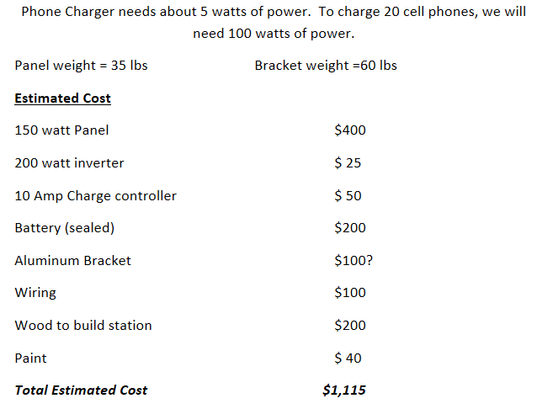
Example Cost Sheet: Solar Charging Station
Notes:
Slide 11: Sample Cost Sheet
Here is an example of a detailed plan of resources needed to build a solar phone charging station. Your plans don’t need to be so detailed on the first day, but this is a good example of how students have planned in the past.

Slide 12
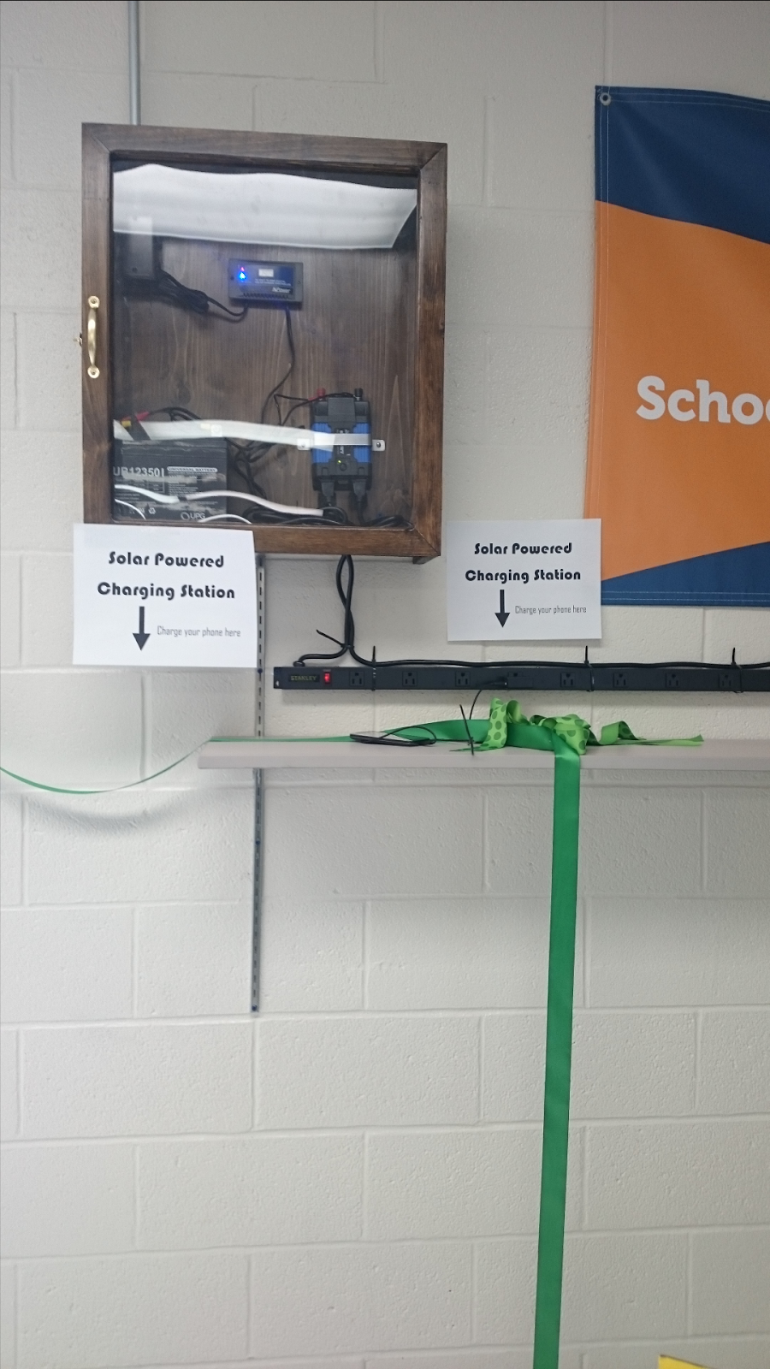
Notes:
Slide 12: Solar Charging Station
All that planning must have helped, because they were able to achieve their goals and build a solar charging station in their school. This project came from Plattsburgh High School, and the students developed their plan at a summit just like this.

Slide 13
STEP 7: How will we measure our success? Who will monitor? What methods can we use?
HOW:
WHO:
WHAT:
Notes:
Slide 13: Monitor Success
Many successful teams start off their CAP project by answering the question “What would ‘success’ look like for this project?” Take some time in your planning process to ask yourself this question. Your definition of success might change as you work on your project, but remember to revisit the question “what would ‘success’ look like?” at least once a month. This helps evaluate evaluate what is working and what isn’t.
Once again, SMART Goals are incredibly important, and if you’ve done a good job making your goals specific and measurable, the monitoring of your success is easy. For example, If you said you wanted to improve recycling in classrooms by presenting to all students during homeroom, and you said you would check the recycling bins once a week to count the number of items being recycled, and you said you would present to 5 classrooms a month for every month of the fall semester, measuring success becomes much easier!
With any project, there is always something you can measure, from watt usage in an outlet, to responses to a survey, to number of vegetables grown in your garden, to number of attendees at an event. Measurable items are easier to understand than just saying something was ‘good’ or ‘bad’.
Once you have a set of specific and measurable goals, assign them to individual people, and when the time comes to monitor success (monthly, weekly, biweekly, it is up to you, but choose a consistent interval) check in on one another to see how you are doing. It should not be one person’s job to check in with everyone else, teamwork makes the dream work! Whenever you start a meeting, it is always helpful to have each member share their progress, or take the time to ask for help.

Slide 14
STEP 8: Communication
Who do we need to keep informed regarding our progress?
How can we spread the word about what we are accomplishing?
Notes:
Slide 14: Communication
Communication will make your project more fun! Just because you are the ones that came up with your project doesn't mean you have to be the only ones executing it. Try to involve more people by showing them how easily your project can fit into and impact their life. Think about all the different strategies for spreading the word about your project - social media, posters, newsletter/newspaper articles, radio, etc. Be creative!
Also, try to set a communication goal for each group of people that you marked on the “Who will help you make this happen?” checklist from Slide 7. How often should they be updated? What do they need to know? What should you ask them?

Slide 15
Reference your Climate Action Plan often and have it available at all of your meetings!
Notes:
Slide 15: Reference your CAP
The point of filling out a Climate Action Plan now is so that you have to think, decide, and deliberate as little as possible in the future! If you have a month-by-month goals list already created now, all you have to do in five months is walk into your meeting, pull out the Climate Action Plan, and read it! A quick review of your CAP should be a part of every meeting. We suggest making a scan of the completed CAP and sharing it on Google Drive with everyone involved.

Slide 16
DOCUMENT EVERYTHING!!
Notes:
Slide 16: Document Everything
If you’re doing a super cool project, other people are going to want to learn from your process or maybe replicate it at their own schools, so make sure you document everything you’re doing, what worked well, and what didn’t. The students who created the Carbon Neutral Prom eventually wrote up a short guide for other students to use if they wanted to replicate the project. Documenting everything also fits into the Measurable aspect of SMART goals!

Slide 17
QUESTIONS?
Notes:
Slide 17: Questions?
Ask students if they have any questions.

Slide 18
What’s Next?
Making your CAP - 45 minutes
Group Share Out - 10 minutes
Next Steps - 5 minutes
Notes:
Slide 18: CAP Agenda
Making your CAP! (Minutes 25-70)
Alright everyone, I’m sure you’re itching to get started, go grab your group, grab your CAPs and get going! We’ll meet back here in about 45 min. to share our plans. There is flip chart paper, markers and other supplies outside this room if any team needs supplies.
Group Share Out (70-80)
Let’s have one representative from each group come up and give a 30 second pitch on their school’s Climate Action Plan!
Next Steps & Wrap Up(80-90)
Thank you so much everyone! I’m super excited to hear all of these awesome ideas and can’t wait to see them all come to life. I want to remind you of some resources you have available to help you with your CAP along the way.

Slide 19
Add information from your summit on what Climate Action Plan follow-up resources and support are available to students.
Notes:
Slide 19: CAP Project Follow-Up Resources
Describe what follow-up support and resources are available to students after your summit. See the Climate Action Plan Facilitator Guide for ideas and options for what follow-up support could look like based on capacity.

Slide 20
Your Youth Climate Summit Network
Notes:
Slide 20:YCS Network & Wrap Up
You are now part of a network of thousands of students working on their own Climate Action Plans across the country, and even across the world. Youth Climate Summits happen every year in many different locations, which means that other students care about this issue, and are working alongside you to implement climate solutions. So reach out to this network as a resource! That could mean talking to other students at this summit, the organizers of this summit, or the professional staff at The Wild Center’s Youth Climate Program.
Remember that there are tons of resources in your own community too! It might help to make a resource map of your school or town so you can reach out and find partners to help you with this project.
Alright, thanks to everyone for all your awesome ideas!
WRAP-UP: Work with students on how they would like to leave the audience feeling hopeful and energized. Here’s one quick idea:
Group chant: Climate Action on 3! One, two, three … CLIMATE ACTION!

